Slide 1
Mapping the synaptic weight using dual-color calcium imaging
20160511

Slide 2
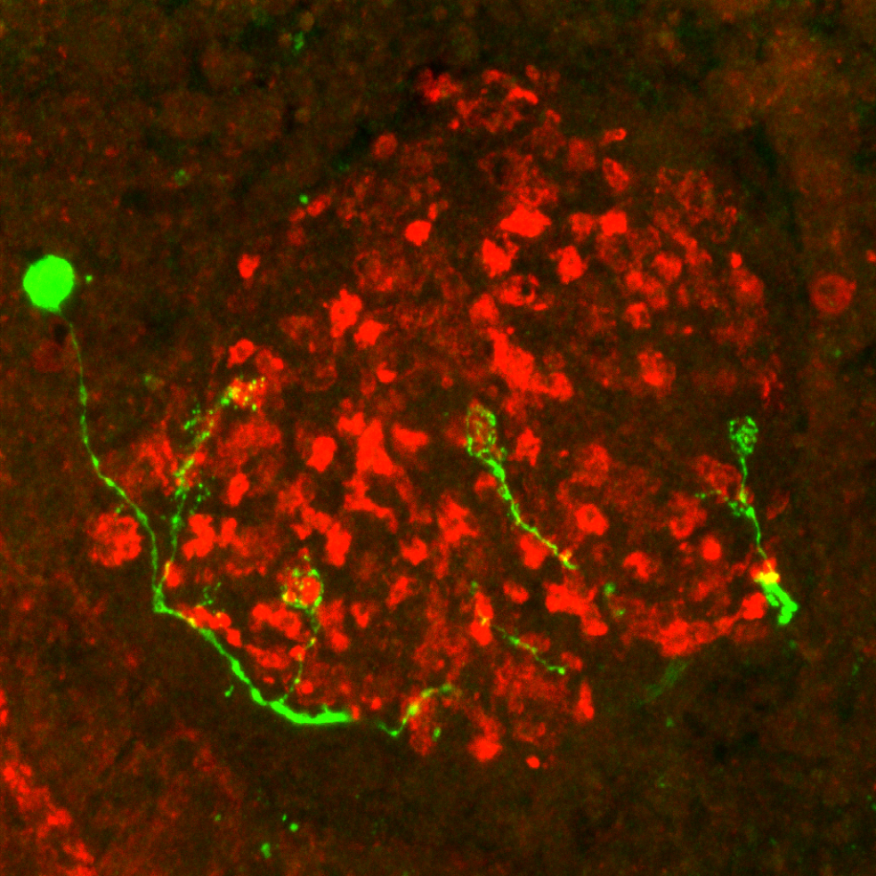
Dual-color calcium imaging
Directly observe the responses at the synaptic sites.
At a large scale
Calcium indicators located to the synapses are need!

Slide 3
How to map the synaptic strength of each claws?
Post-synaptic dendrites
Sensitive dual-color calcium indicators
Proper index for representation
of the synaptic strength
Pre-synaptic terminals

Slide 4
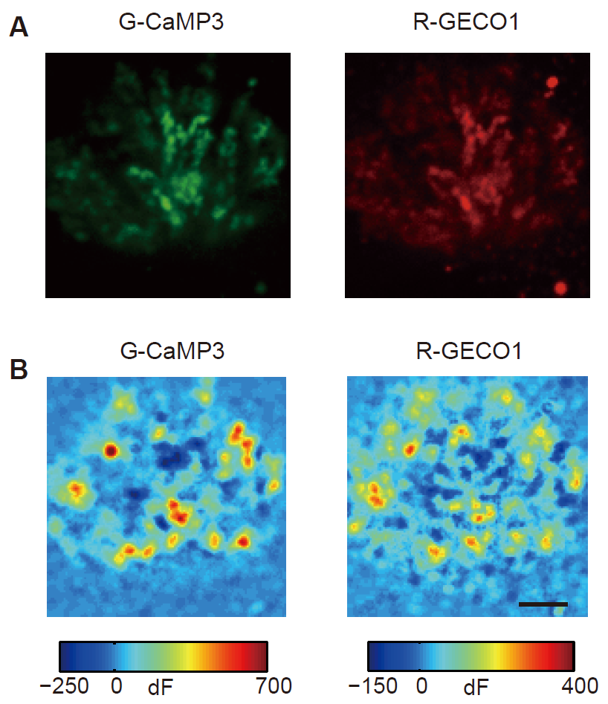
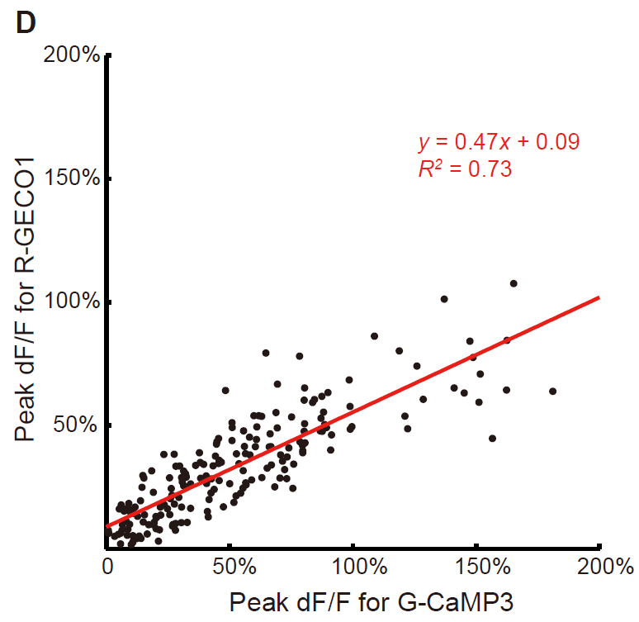
Dual-color calcium imaging

Slide 5
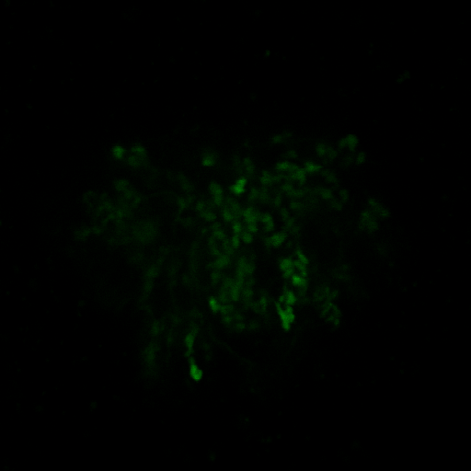
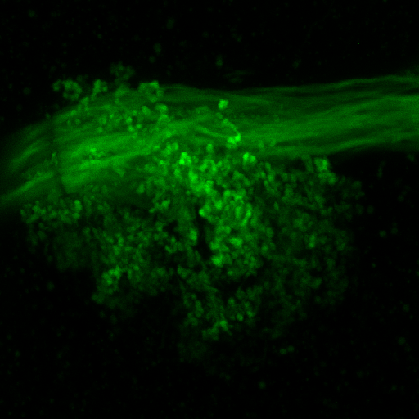
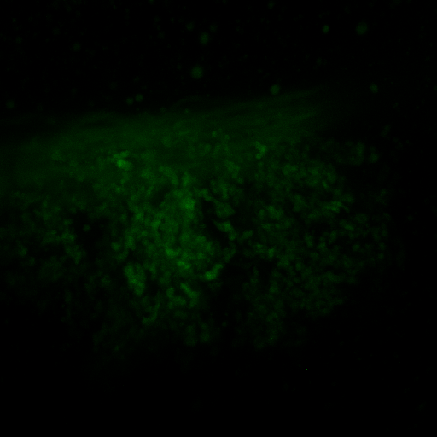
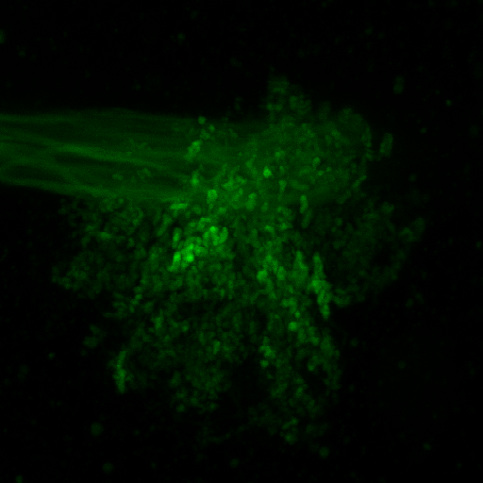
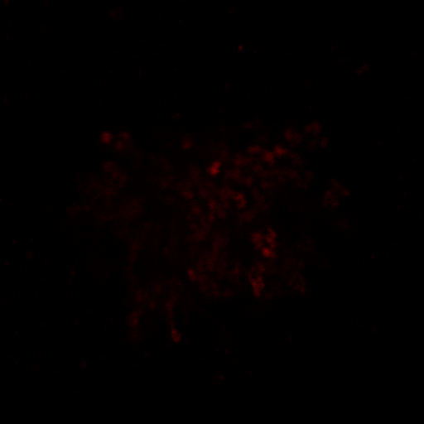
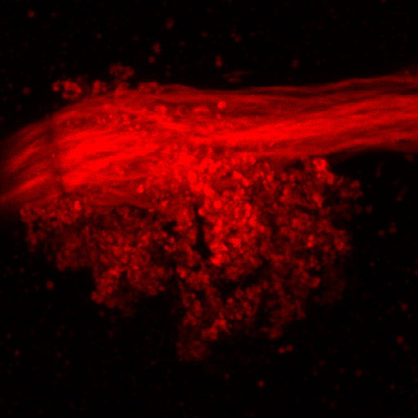
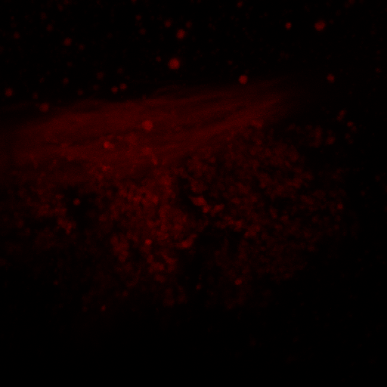
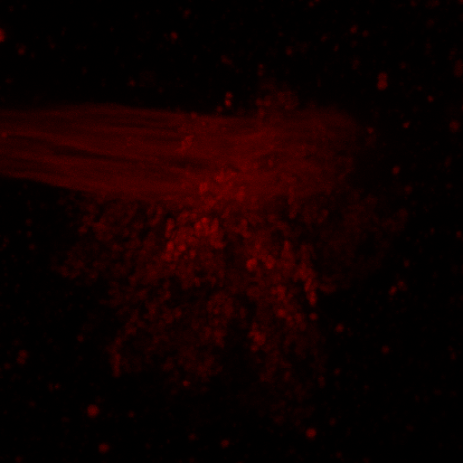
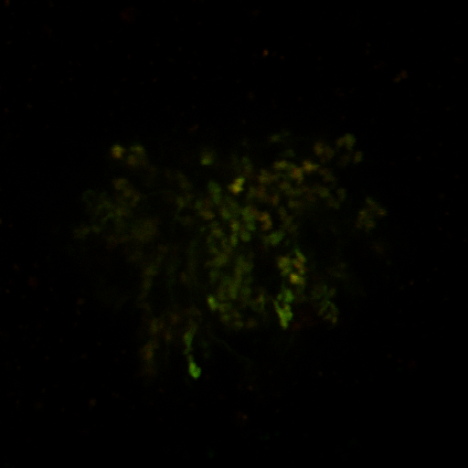
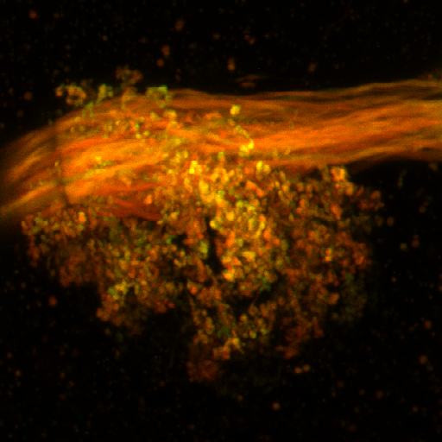
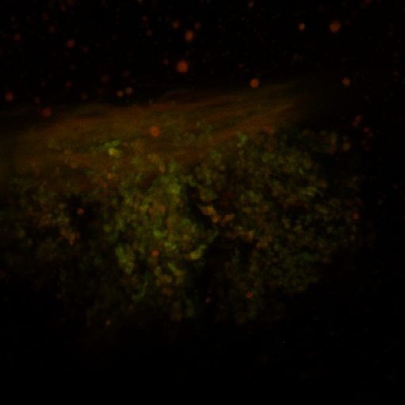
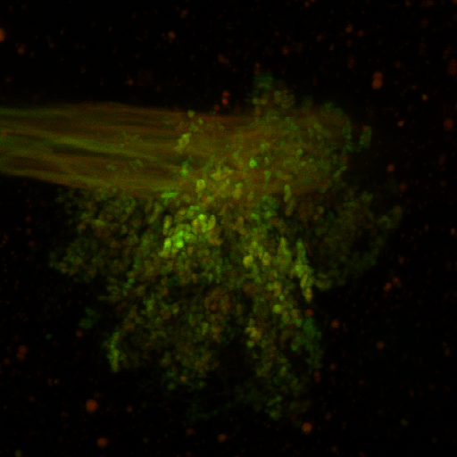
Seeking for sensitive dual-color calcium indicator pairs
Driven by GH146-GAL4
GCaMP6s
Red calcium
indicators
Merge
J-RCaMP1a
J-RCaMP1b
J-RGECO1a
J-RGECO1b

Slide 6
Seeking for sensitive dual-color calcium indicator pairs
GH146 > GC6s
y = 0.5586x + 0.1189
OK107 > GC3

Slide 7
Seeking for sensitive dual-color calcium indicator pairs
GH146 > GC6s
0.4828
OK107 > GC3
0.2923 / 0.4828
0.2923

Slide 8
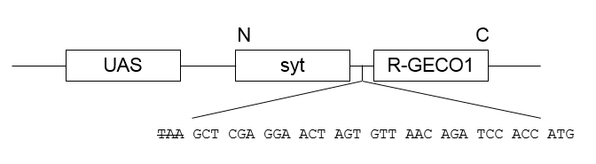
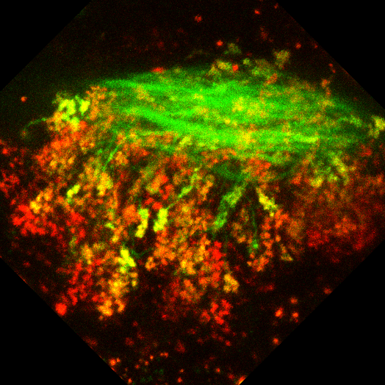
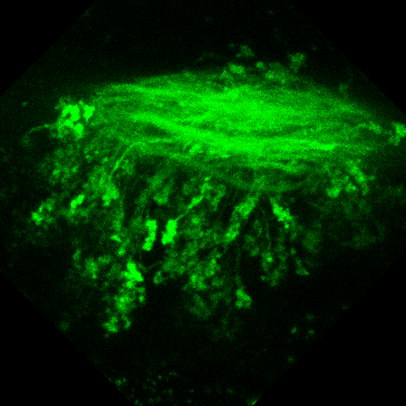
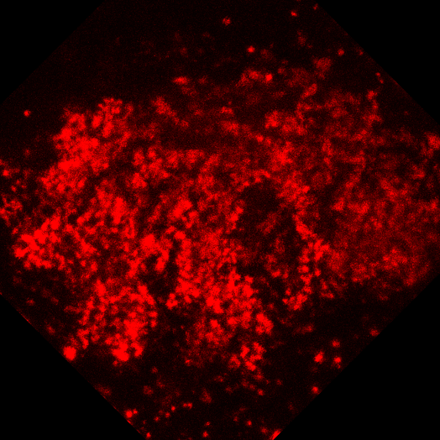
R-GECO located to the synapses is needed
Merge
G-CaMP3
Syt-RGECO1
GH146-GAL4 > UAS-GCaMP3, UAS-syt-RGECO1

Slide 9
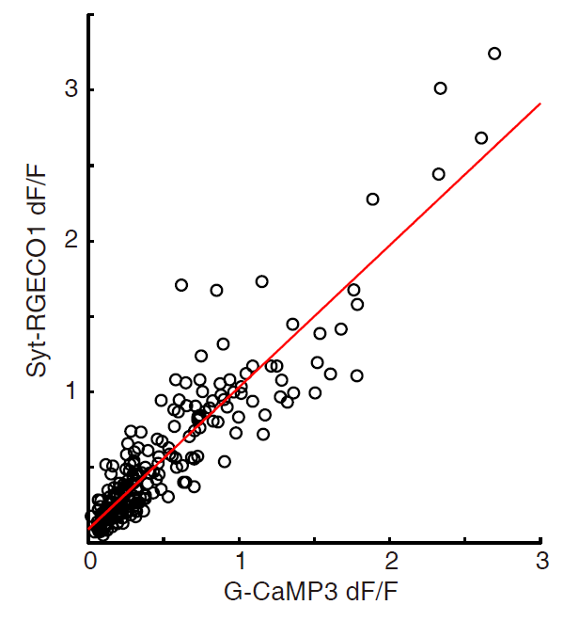
Syt-R-GECO1 vs. G-CaMP3
y = 0.94x + 0.09
R² = 0.83

Slide 10



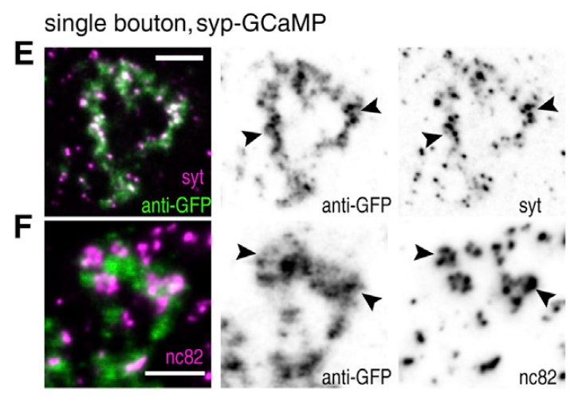
Locate the red indicators to synapses
Merge
G-CaMP3
Syt-RGECO1
UAS
syt
j-RCaMP1b
UAS
syp
j-RCaMP1b
GH146-GAL4 > UAS-GCaMP3, UAS-syt-RGECO1
LexAop
syt
j-RCaMP1b
LexAop
syp
j-RCaMP1b
UAS
syt
j-RGECO1a
UAS
syp
j-RGECO1a
LexAop
syt
j-RGECO1a
LexAop
syp
J-RGECO1a
Pech et al., 2015, Cell Reports

Slide 11
To be continued..

Slide 12
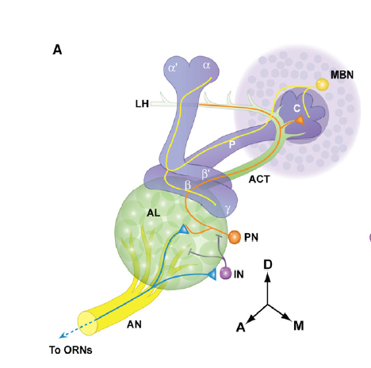
Seeking for proper index for representation of the synaptic strength
Easy stimulation

Slide 13
Seeking for proper index for representation of the synaptic strength
Fit equation：a * x^2 ./ x^2 + c
Notes:
20160420-3

Slide 14
Seeking for proper index for representation of the synaptic strength

Slide 15
Seeking for proper index for representation of the synaptic strength

Slide 16
Seeking for proper index for representation of the synaptic strength
Syt-RGECO1
GCaMP6s
Notes:
[h, atab, ctab, stats] = aoctool(dFF_G_roi1, dFF_R_roi1, dFF_roi_group1);
mulcom = multcompare(stats);

Slide 17
Seeking for proper index for representation of the synaptic strength
Syt-RGECO1
GCaMP6s
Notes:
20160421-1

Slide 18
Seeking for proper index for representation of the synaptic strength
Syt-RGECO1
GCaMP6s
Notes:
20160421-2

Slide 19
Seeking for proper index for representation of the synaptic strength
Syt-RGECO1
GCaMP6s

Slide 20
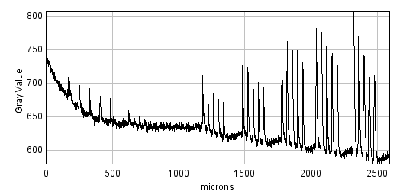
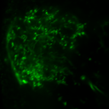
The axons of the PNs also respond to the stimuli
Notes:
20160510

Slide 21

Connective weight from PNs to KCs defined by dual-color calcium imaging
Spontaneous responses
(F – Baseline) / Baseline
How to define the ‘Baseline’ for each event?
Notes:
150627-1L-N1

Slide 22
Connective weight from PNs to KCs defined by dual-color calcium imaging
Shared baseline
Easy stimulation
Different stimulation strength
Different trials
Standard deviation
Individual baseline
Different stimulation strength
Different trials
Standard deviation
Notes:
20160420-2-roi1

Slide 23
Connective weight from PNs to KCs defined by dual-color calcium imaging
CASE 1

Slide 24
Connective weight from PNs to KCs defined by dual-color calcium imaging
CASE 1

Slide 25
Connective weight from PNs to KCs defined by dual-color calcium imaging
CASE 1
Notes:
20150827-1R-2-neuron3 2-3-3 2-3-4

Slide 26
Connective weight from PNs to KCs defined by dual-color calcium imaging
CASE 1

Slide 27
Connective weight from PNs to KCs defined by dual-color calcium imaging
CASE 1

Slide 28
Connective weight from PNs to KCs defined by dual-color calcium imaging
CASE 1
2-3-3
2-3-4
KC
PN

Slide 29
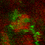
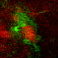
Connective weight from PNs to KCs defined by dual-color calcium imaging
CASE 1
2-3-3
2-3-4

Slide 30
Connective weight from PNs to KCs defined by dual-color calcium imaging
CASE 2
Notes:
150807-1R

Slide 31
Connective weight from PNs to KCs defined by dual-color calcium imaging
CASE 2

Slide 32
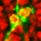
Connective weight from PNs to KCs defined by dual-color calcium imaging
CASE 2
Two different claws of a same neuron receive nearly identical inputs and have identical responses.

Slide 33
Connective weight from PNs to KCs defined by dual-color calcium imaging
CASE 3
Notes:
150724-1L

Slide 34
Connective weight from PNs to KCs defined by dual-color calcium imaging
CASE 3

Slide 35
Connective weight from PNs to KCs defined by dual-color calcium imaging
CASE 3
1-1-21
1-1-41

Slide 36
These are the claws from the same layer.
However, cases like this are very rare.
We need to compare different claws from different layers for more analysis.
As the lasers may have different bleaching effect on the two calcium indicators,
data should be carefully selected.

Slide 37
One claw imaging for three sections

Slide 38
One claw imaging for three sections

Slide 39
Connective weight from PNs to KCs defined by dual-color calcium imaging
CASE 4
KC
PN
Notes:
20150827-1R-neuron2: 121, 第一次拍摄， 第二个神经元， claw编号1， 以此类推。此处留待讨论，因为521的强度明显高于121

Slide 40
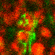
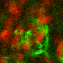
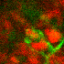
CASE 4
1-2-1 2-2-4 3-2-3

Slide 41
Connective weight from PNs to KCs defined by dual-color calcium imaging
CASE 5
需要设置一个值筛选数据
Notes:
20150827-2R 因为红色的会bleach的原因，所有的数据都只选择1-3层进行分析。

Slide 42
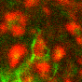
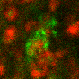
CASE 5

Slide 43
Connective weight from PNs to KCs defined by dual-color calcium imaging
CASE 6
Notes:
1—1 vs 2-2 20150828-1L

Slide 44
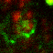
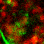
Connective weight from PNs to KCs defined by dual-color calcium imaging
CASE 6
1-1
2-2
Notes:
1—1 vs 2-2 20150828-1L

Slide 45
CASE 7
Notes:
20150828-1R-Neuron2

Slide 46
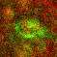
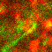
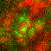
CASE 7

Slide 47
Connective weight from PNs to KCs defined by dual-color calcium imaging
CASE 8
Notes:
20150828-1R-Neuron1

Slide 48
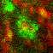
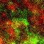
Connective weight from PNs to KCs defined by dual-color calcium imaging
CASE 8

Slide 49
Connective weight from PNs to KCs defined by dual-color calcium imaging
Pre (syt-RGECO1)
Post (GCaMP6s)
Notes:
20150827-1R-neuron2: 121, 第一次拍摄， 第二个神经元， claw编号1， 以此类推。此处留待讨论，因为521的强度明显高于121

Slide 50
Connective weight from PNs to KCs defined by dual-color calcium imaging
Notes:
20150827-2R 因为红色的会bleach的原因，所有的数据都只选择1-3层进行分析。

Slide 51
Connective weight from PNs to KCs defined by dual-color calcium imaging
Notes:
1—1 vs 2-2 20150828-1L

Slide 52
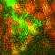
Connective weight from PNs to KCs defined by dual-color calcium imaging
Notes:
中间第二个这个意思基本就是说这里绿色的反应大小跟红色的没什么关系咯
20150828-1R-Neuron1
115
314
316

Slide 53
Connective weight from PNs to KCs defined by dual-color calcium imaging
Notes:
20150828-1R-Neuron2
123
224
322

Slide 54
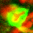
Connective weight from PNs to KCs defined by dual-color calcium imaging
Notes:
150821-6L
3-1
4-7
5-5

Slide 55
Connective weight from PNs to KCs defined by dual-color calcium imaging
Notes:
两个complex claw~~~没有显著差异
150724-1L

Slide 56
Connective weight from PNs to KCs defined by dual-color calcium imaging

Slide 57
Correlation coefficient: 0.7216

Slide 58
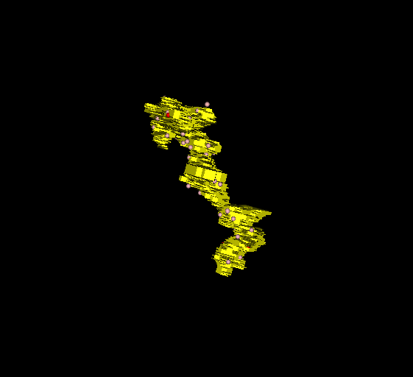
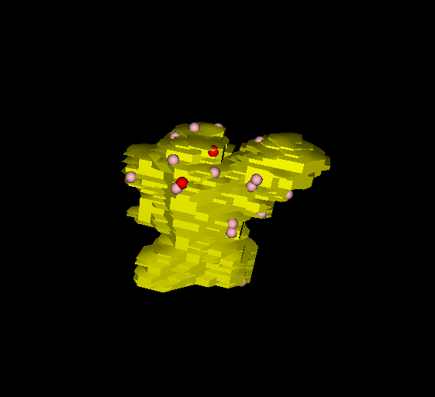
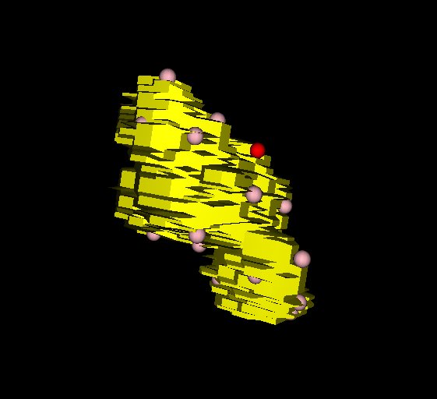
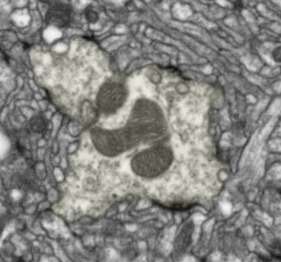
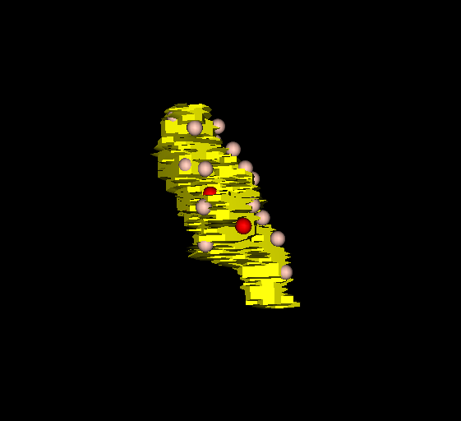
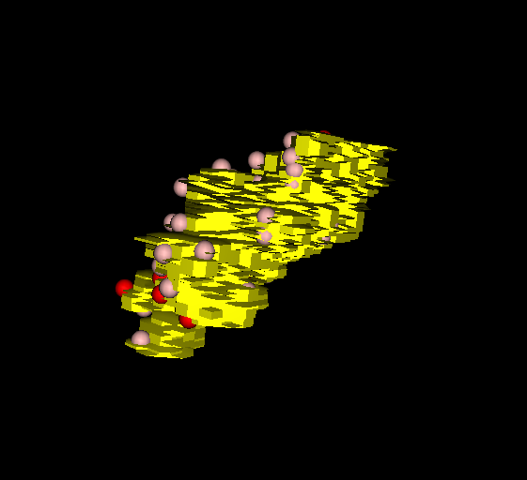
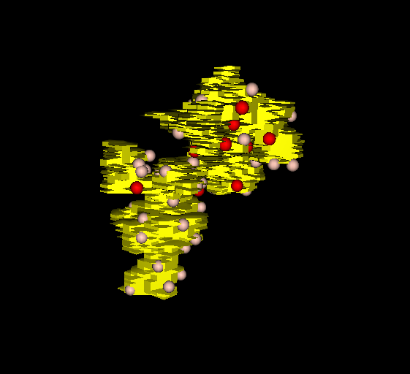
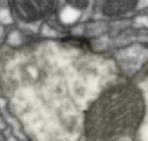
Volume (um^3): 17.35 6.97 6.25
Single-T-bar + Double-T-bar: 55 + 15 30 + 3 27 + 3
Volume (um^3): 5.48 10.45 15.29
Single-T-bar + Double-T-bar: 23 + 5 47 + 9 66 + 13

Slide 59
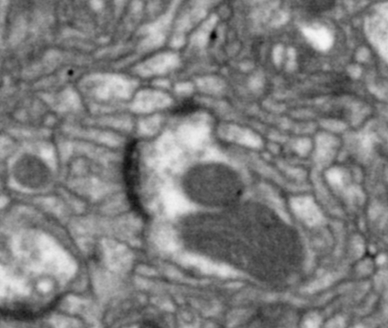






Volume (um^3): 3.91 12.16 20.19
Single-T-bar + Double-T-bar: 18 + 6 45 + 12 71+18
Volume (um^3): 11.27 11.81 18.26
Single-T-bar + Double-T-bar: 40 + 18 42 + 14 46 + 34

Slide 60



Volume (um^3): 8.19 9.22 13.25
Single-T-bar + Double-T-bar: 30 + 16 31 + 13 42+20

Slide 61
Single-T-bar + double-T-bar
Single-T-bar + 2 * double-T-bar
Volume
Volume

